Slide 1
Glounthaune Knotweed Eradication Plan
GTTC Survey Results
28th October 2014
Plan
Budget

Slide 2
Introduction
Following a meeting 22th October with CCC and the Glounthaune Tidy Towns (GTTC) Knotweed Sub-committee it was agreed:
GTTC would survey the extent of the problem
CCC would investigate methods and resources
GTTC/CCC would meet 5 Nov14 (revised to 17 Nov 14) to review and plan a course of action

Slide 3
Survey Methodology
A visual/quantities survey between Killacloyne Bridge and Bury’s bridge was undertaken
All identified areas of knotweed infestation sites key parameters recorded in line with UK guidelines and databased
Estimates of stem height, thickness, density, infestation area, and infestation area usage and perceived ownership logged

Slide 4
Limitations to Methodology
Due to extensive infestation on Irish rail property it was not possible to accurately log all sites and observations are probably underestimated
Areas accuracy of any one site is better than +_20%
Area estimates do NOT include a 7m boundary to allow for lateral spreading.
Due to cutting of roadside verges some infestations may not have been visible
Stem number estimates are made from a number of random samples using a 1/3m2 measuring template and counting stems in around 12.5% of identified roadside sites

Slide 5
Summary Key Numbers
GTTC estimate Knotweed infestation Area as 0.624 Hectares (6260m2)
This comprises an estimated 168,500 plants in 75 sites
Sites range from single stems to over 600m2
Primary locations are along roadsides and Railways with some evidence of spreading into adjacent private property
66% by area is on CCC property, 25% on Irish Rail , 6% straddle the boundary between IR/CCC and 2% on private property

Slide 11
Glounthaune Knotweed Eradication Plan
Key Objectives, Methods

Slide 12
Key Objectives
Make Glounthaune a Knotweed free area in 3/5 years
100% of site under treatment by end 2015
Stop practices that spread infestation end 2014
Commence treatment in spring 2015
Confirm plan and budget for 2015 end November 2014
Mobilize the community, owners and manpower

Slide 13
Methods of control
4 methods of control identified
Bury and cover – impractical given in place infrastructure and required budget
Foliar Spray – works, but takes several seasons
Stem Injection – very effective, requires specialist injector gun, safe but labour intensive
Cut and pour – very effective, but labour intensive: problem with cut stems disposal

Slide 14
Our Proposal
Stem injection on roadside adjacent site
Foliar spray of restricted/difficult sites - commencing spring
Experiment with cut and pour on one site
Labeling of all infected sites per Kerry example
Immediate cessation by CCC of practice of flailing roadside knotweed infestations and CCC to gather up flaid material and dispose of safely.

Slide 15
Methodology CCC
Sign all sites and fnalise treatment
CCC to procure site notices
Safety paramount
Work in teams of 3 – 1 member responsible for safety
Spray where safety and accessibility problematic
Spray spring and early autumn and repeat annually
Sub-contract spraying to professionals: use height to spray down on foliage
Team of 3: 1 sprayer, 1 operator, 1 safety
Stem Inject all other areas
Teams of 3, 2 injectors/1safety and clearer
Target 27m2/hr
Resurvey October 2015 and report

Slide 16
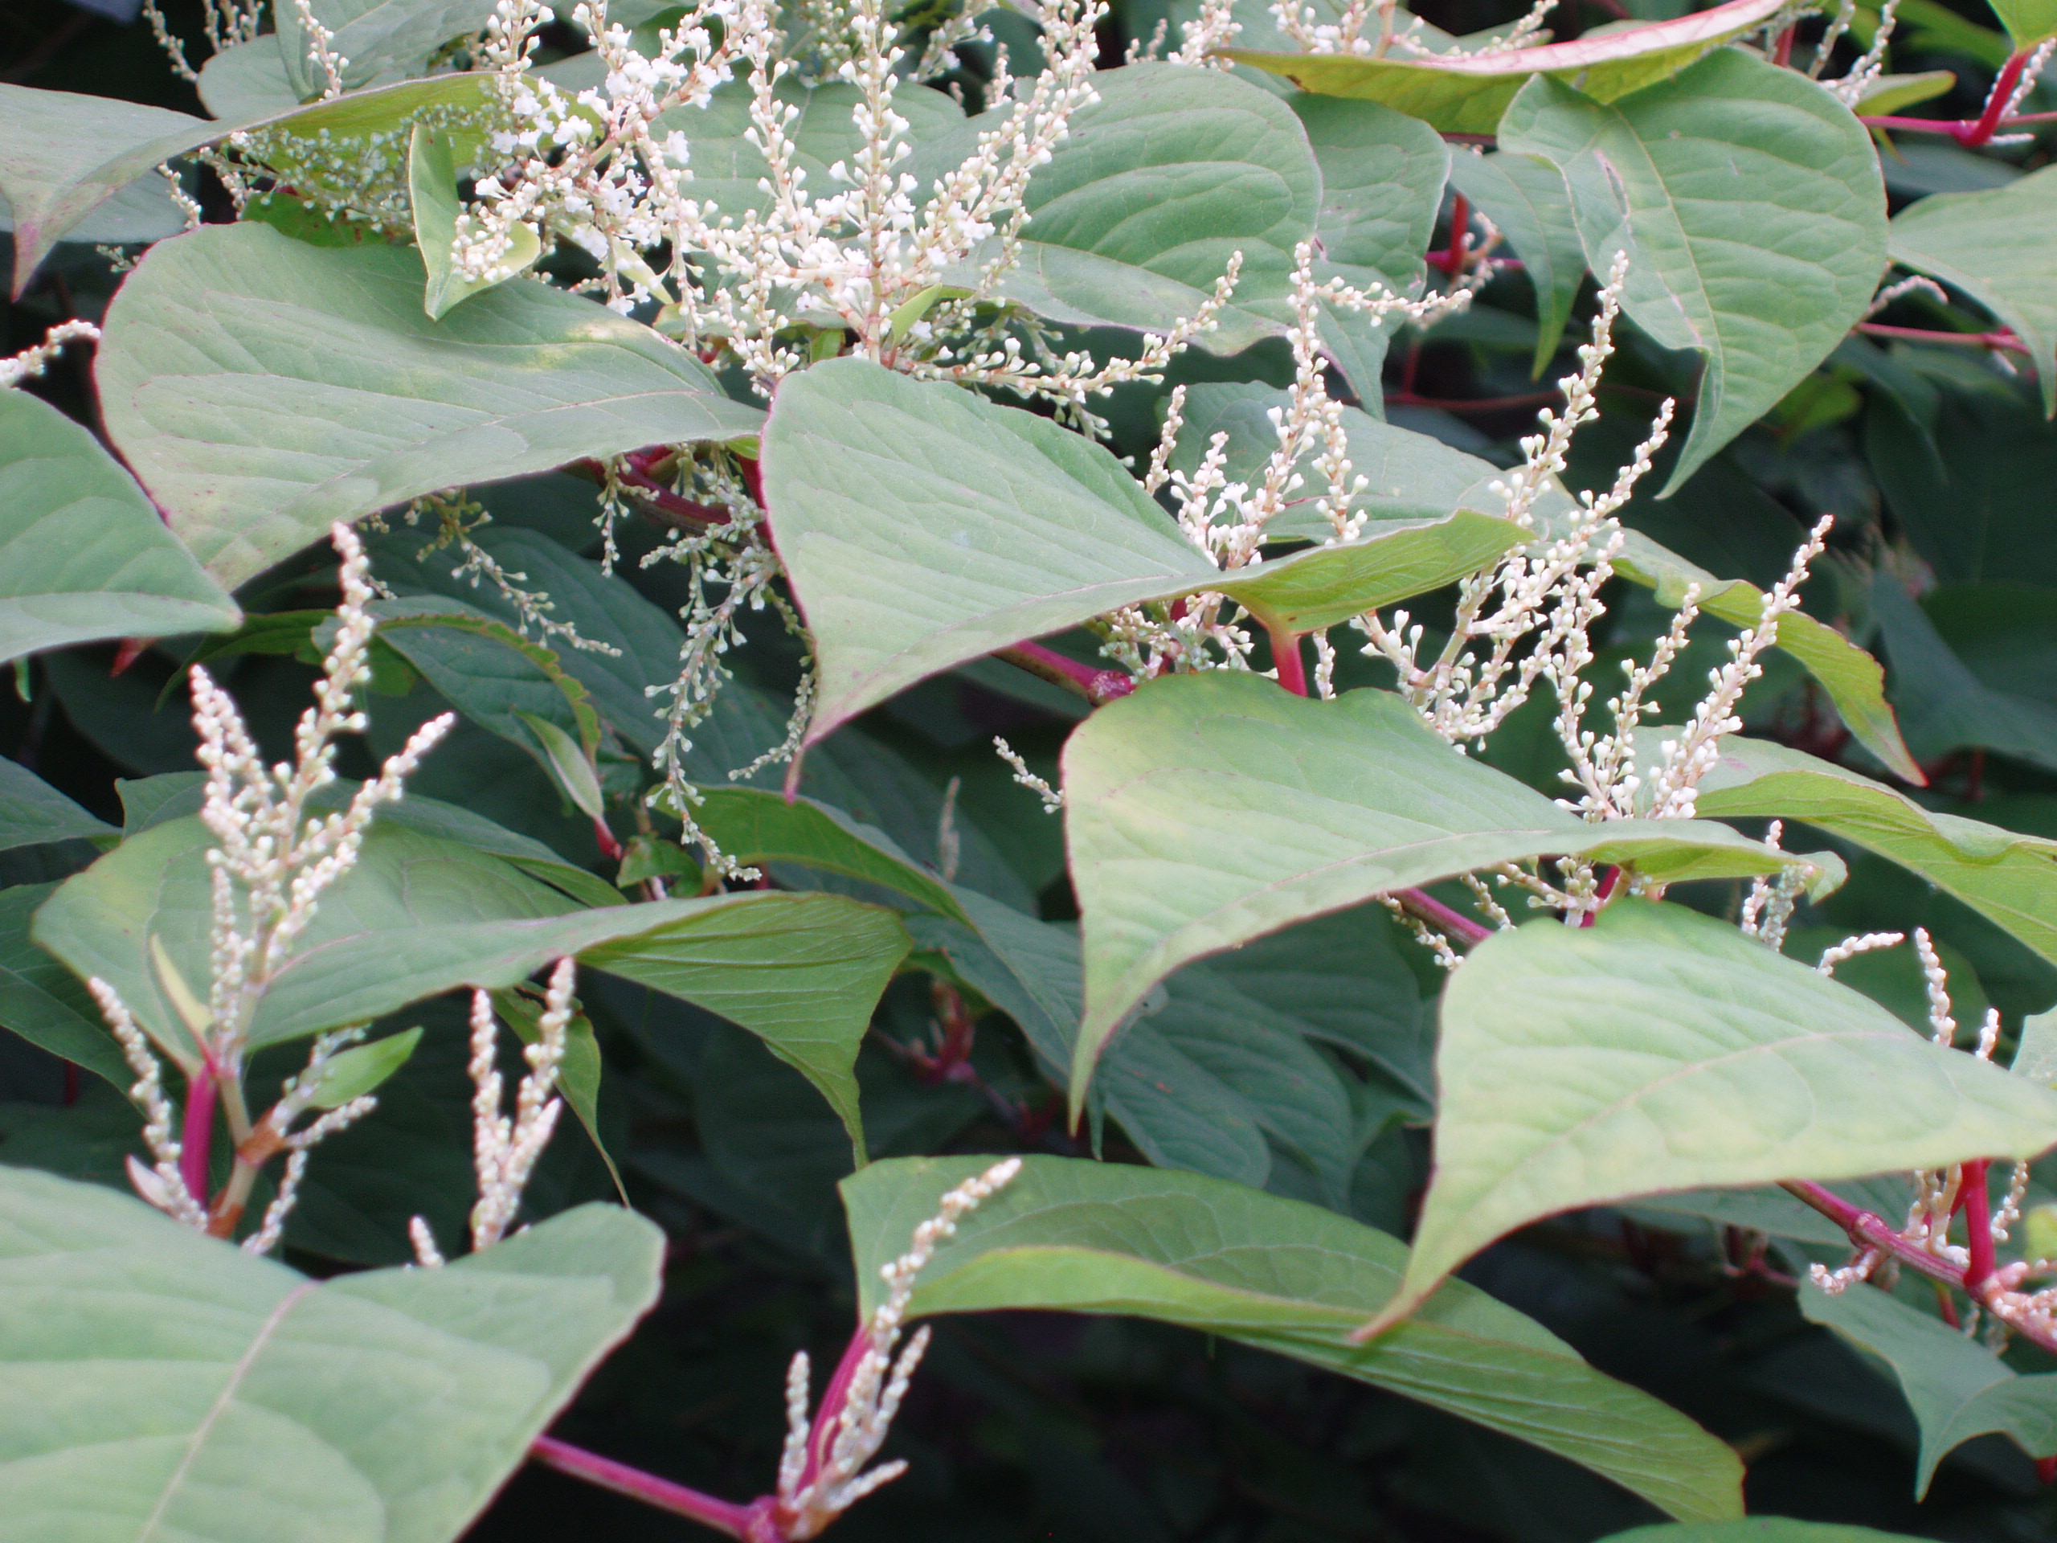
Japanese Knotweed Under Treatment
Notice
Cork County Council
Glounthaune Tidy Towns
Committee
Do not cut, remove or spread material from this site.
Legal penalties apply –
European Communities (Birds and Natural Habitats 2011.
 | Year | Spring | Summer | Stem Inject | Foliar Spray
2015
2016
2017
Fallopia Japonica

Slide 17
Methodology IR/IRCCC Sites
Meet IR with CCC and establish joint approach
Establish joint plan of action

Slide 18
Other sites
GCTT to work with Ashborne House and Rockgrove and offer to stem inject.
NRA: CCC/GCTT to approach. GCTT could stem inject site with appropriate safety measures.

Slide 19
Budget Cost
Budget Summary Euros
 | CCC | IR | AH | IR/CCC | RG | NRA | Total
2015 | 4475 | 2463 | 126 | 416 | 84 | 27 | 7565
2016 | 2974 | 2463 | 49 | 416 | 33 | 10 | 5934
Capital 2015 | 1750 | 0 | 0 | 0 | 0 | 0
Costs include material, professional spraying, height hire,
Labour for injecting costed at €25/hr.
Capital cost includes cost of two injectors, spare needles, protective
equipment + misc budget of €250
All items will be billed without mark-up to CCC.
Assumed CCC will procure and provide signage to agreed specification

Slide 20
 | 2015 Budget Knotweed Eradication Glounthaune
Materials |  | CCC | IR | AH | IR/CCC | RG | NRA | Total
 | Area Estimate | 4114 | 1572 | 93 | 400 | 62 | 20 | 6261
 | Spray | 50% | 100% | 0% | 100% | 0% | 0% | 64% | Estimate
 | Stem Inject | 50% | 0 | 100% | 0% | 100% | 100% | 36% | Estimate
 | Stem density | 27 | 27 | 27 | 27 | 27 | 27 |  | Stems/m2
 | Inject Insecicide | 111 | 0 | 5 | 0 | 3 | 1 | 121 | Litres
 | Spray 10l/ha | 10 | 8 | 0 | 2 | 0 | 0 | 20 | 2 sprays
 | Cost/litre € | 8 | 8 | 8 | 8 | 8 | 8 | 48 | Co-op
 | Herbicide Cost | 971 | 63 | 40 | 16 | 27 | 9 | 1125 | €
 | Height Hire | 1000 | 0 | 0 | 0 | 0 | 0 | 0
 | Total Materials | 1971 | 63 | 40 | 16 | 27 | 9 | 1125
Labour Estimate
Spraying | Spring | 2 | 3 |  | 0.5 |  |  |  | days
 | Safety | 4 | 6 |  | 1.0
 | Late Summer | 2 | 3 |  | 0.5
 | Cost Per day | 200 | 200 | 200 | 200 | 200 | 200 |  | €
 | Sub total spraying | 1600 | 2400 | 0 | 400 | 0 | 0 |  | €
Injection | Area m2 | 2057 | 0 | 93 | 0 | 62 | 20 |  | m2
 | No Hours | 76 | 0 | 3 | 0 | 2 | 1 | 0 | hrs
 | Cost per hour | 25 | 25 | 25 | 25 | 25 | 25 |  | €
 | Labour Injection | 1905 | 0 | 86 | 0 | 57 | 19 | 2067 | €
 | Total Variable | 4475 | 2463 | 126 | 416 | 84 | 27 | 7592 | €
 | Capital | 1750
 | Capital Costs
 | Injectors by 2 | 1100
 | spare needles | 100
 | Protective Gear | 300
 | Misc | 250
 |  | 1750

Slide 21
Glounthaune Community Association – Tidy Towns Committee
Run by professionals – with extensive chemical and safety expertise
History of involvement and project delivery
“Pride of Place” Winner
Committed to making Glounthaune a better environment

